Slide 1
Innovation
Design Thinking Focus
Design Thinking
Identifying Customer Needs
Creative Solutions or Gaps - Apply philosophy to business problems
Market Assessment of Innovation
Technology Assessment of Innovation

Slide 2
Innovation..
a new or improved product or process (or a combination thereof) that differs significantly from the unit’s previous products or processes and that has been made available to potential users (product) or brought into use by the unit (process).”

Slide 3
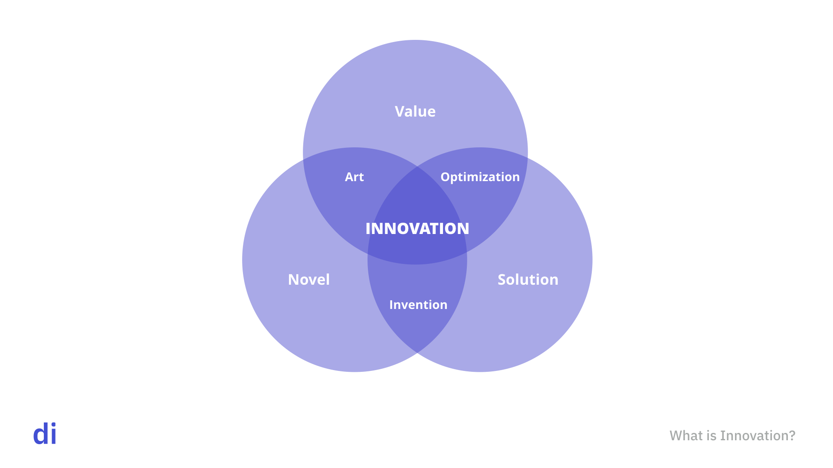

Slide 4
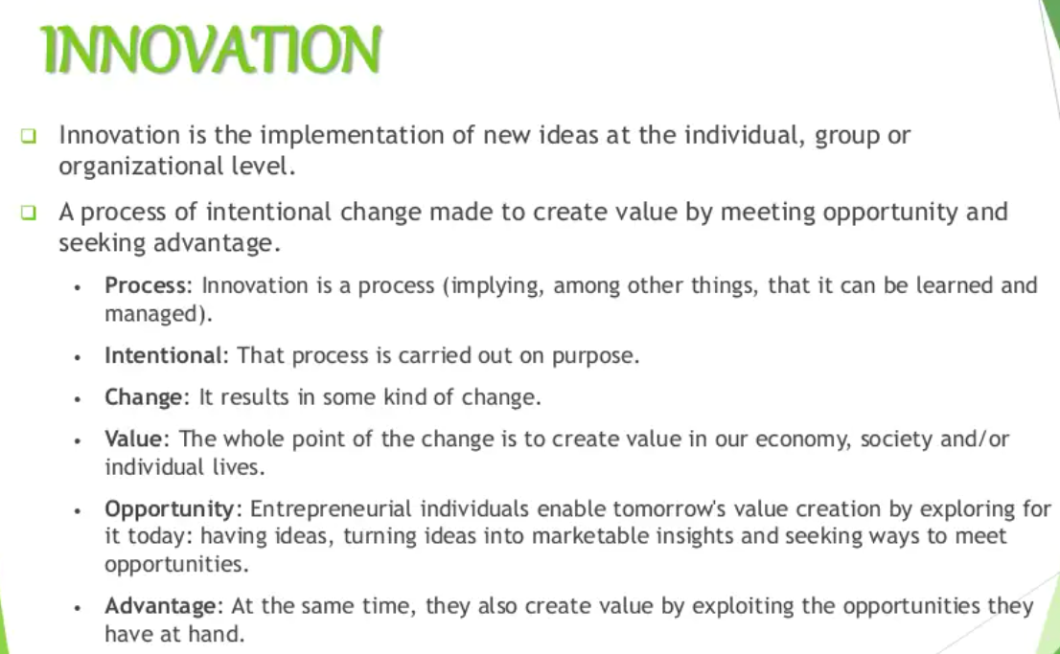

Slide 5
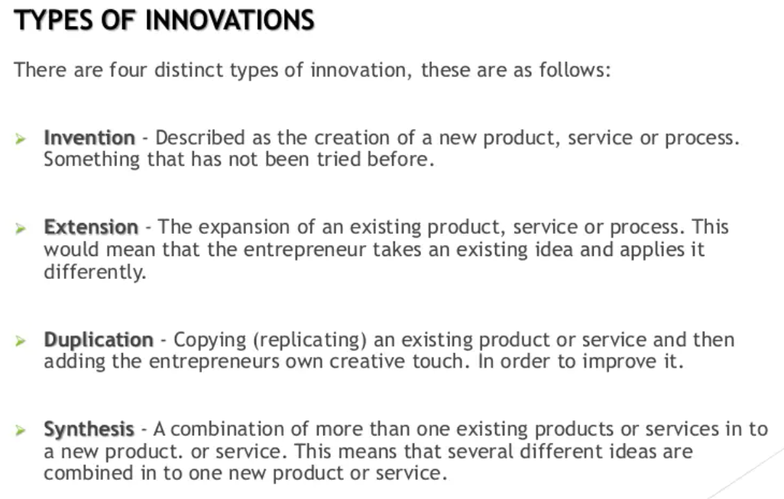

Slide 6
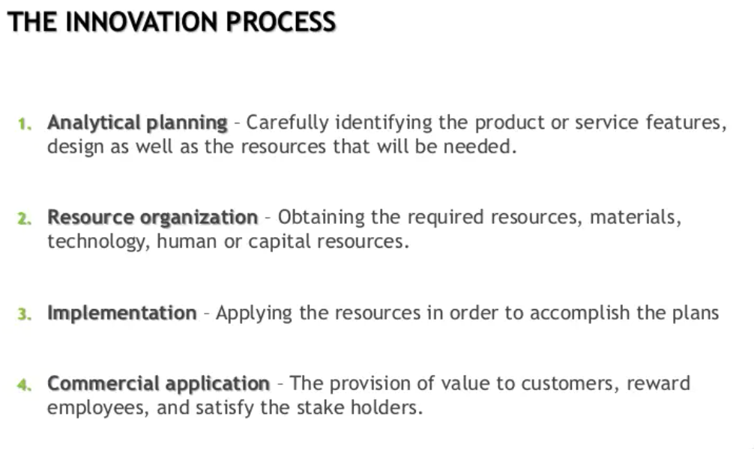

Slide 7
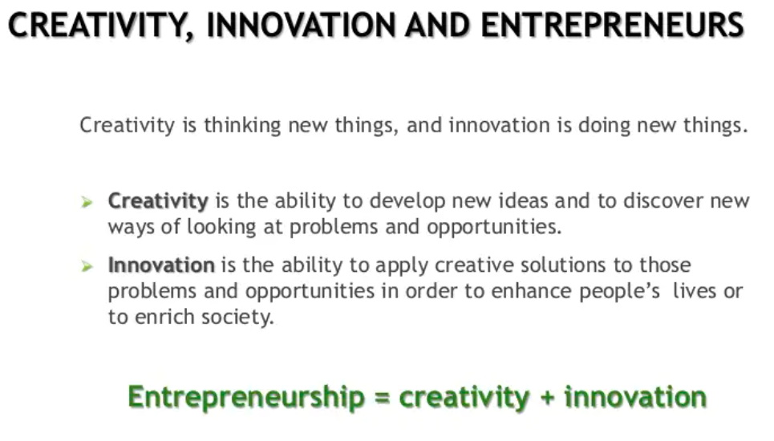

Slide 8
Recap..
Organizational Innovation
Process Innovation
Product Innovation
Marketing Innovation

Slide 9
Recap..
Innovation means
Artists vs. Innovators
Business Context
Sources: D, School, IDEO, Interaction Design org.

Slide 10
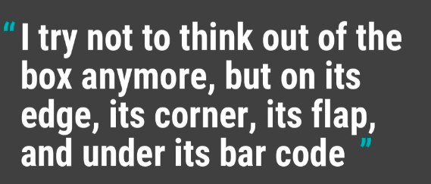
Out of Box Thinking

Slide 12
What & Why of Design Thinking
Creative Problem Solving
Can creativity be a process
If it is then can we learn for applying it to business problems
Who is a Designer
What is Design thinking
Quote:
Design Thinking is not an exclusive property of designers—all great innovators in literature, art, music, science, engineering, and business have practiced it. So, why call it Design Thinking? What’s special about Design Thinking is that designers’ work processes can help us systematically extract, teach, learn and apply these human-centered techniques to solve problems in a creative and innovative way – in our designs, in our businesses, in our countries, in our lives

Slide 13
Design Thinking - Definition
Design Thinking is an iterative process in which we seek to understand the user, challenge assumptions, and redefine problems in an attempt to identify alternative strategies and solutions that might not be instantly apparent with our initial level of understanding.
Design thinking has a human-centered core. It encourages organizations to focus on the people they're creating for, which leads to better products, services, and internal processes.
How do they interact with products ?
Where and Why ?
Nomenclature & Principles: Nobel laureate Herbert Simon in The Sciences of the Artificial in 1969.
3 - 7 phases

Slide 14
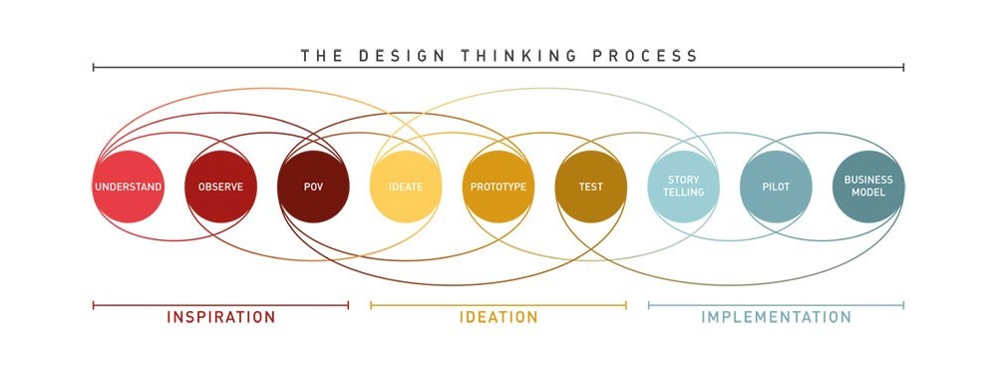
Design Thinking (Process)

Slide 15
Popular Design Thinking Frameworks
Heart, Head and Hand
The Design Thinking Process is a blend of Heart, Head and Hand. This means the process is based on vision, need, emotion and feeling to begin with, continuing on to the cognitive processing for ideation and evaluation and then diving into practical creation by hand.

Slide 16
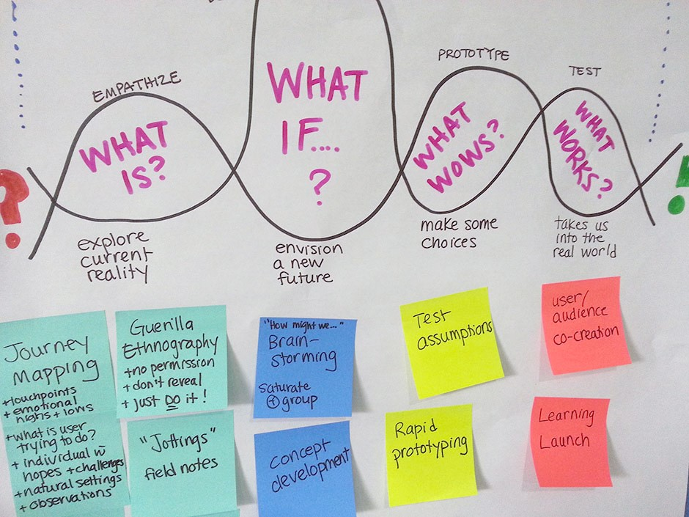
What x4 Principles

Slide 17
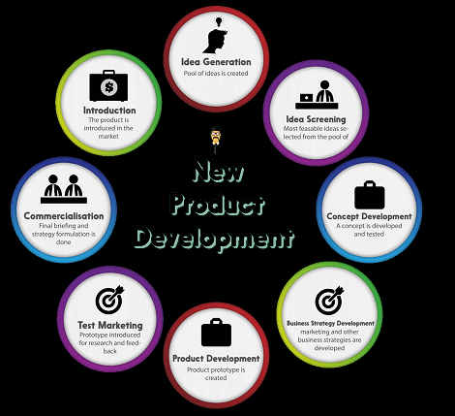
Concept Development

Slide 18
IDEO - Deep Dive
The Deep-Dive process comprises of the following steps:
Understand
Observe
Visualise
Evaluate
Implement
The Deep-Dive process comprises of the following steps:
Understand
Observe
Visualise
Evaluate
Implement

Slide 19
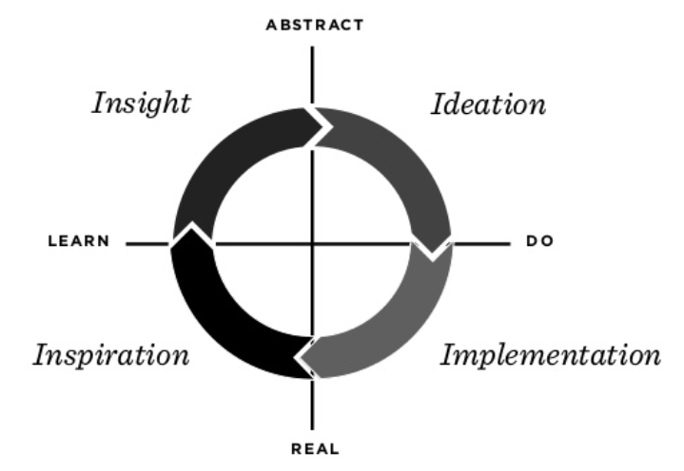
IDEO Steps ..

Slide 20
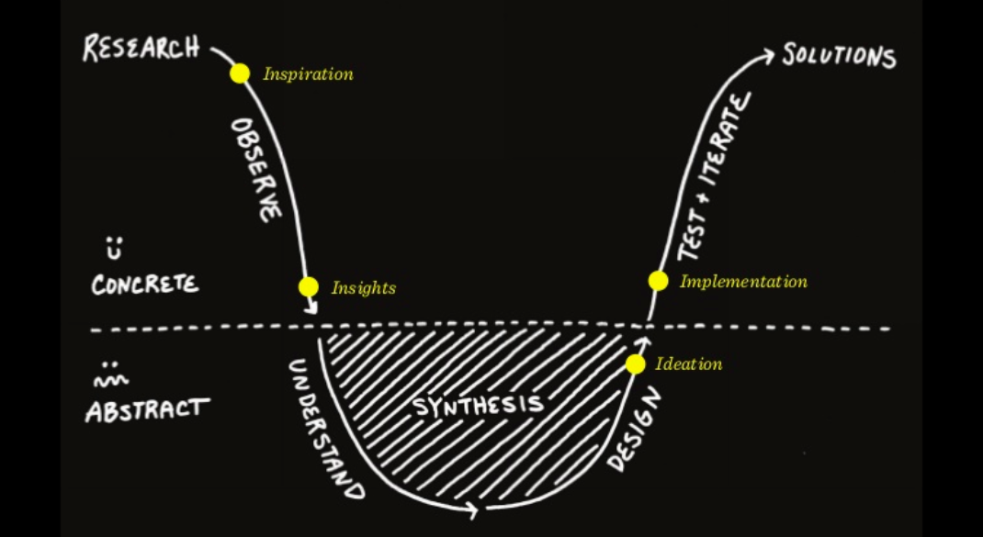
and the design flow..

Slide 21
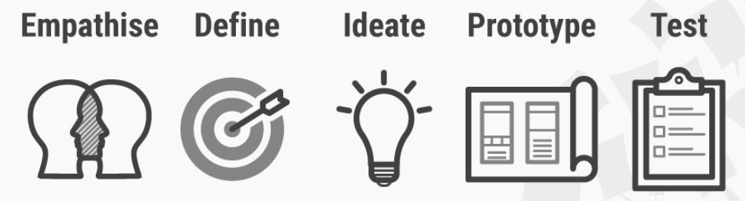
D.school Modes of Design Thinking - Non Linear Cards
five-phase model proposed by the Hasso-Plattner Institute of Design at Stanford - d.school

Slide 22
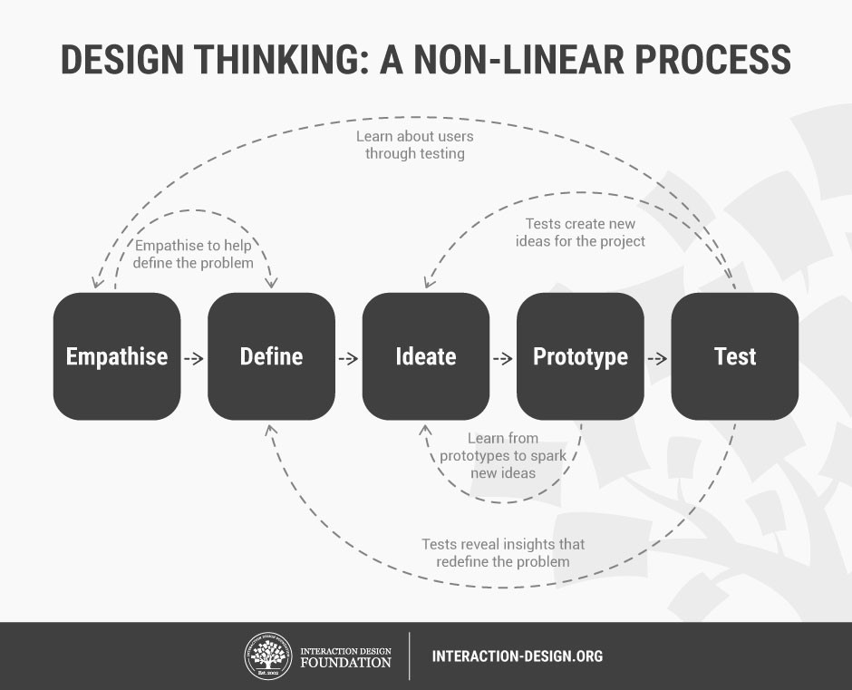

Slide 23
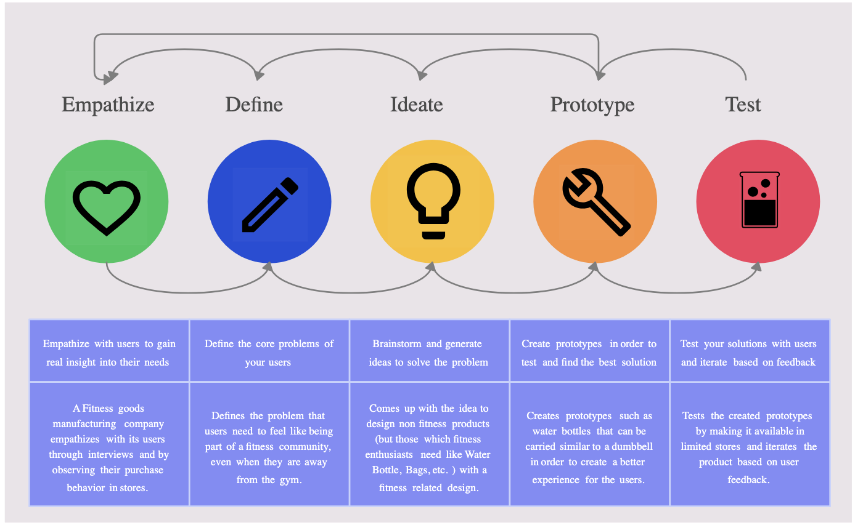

Slide 24
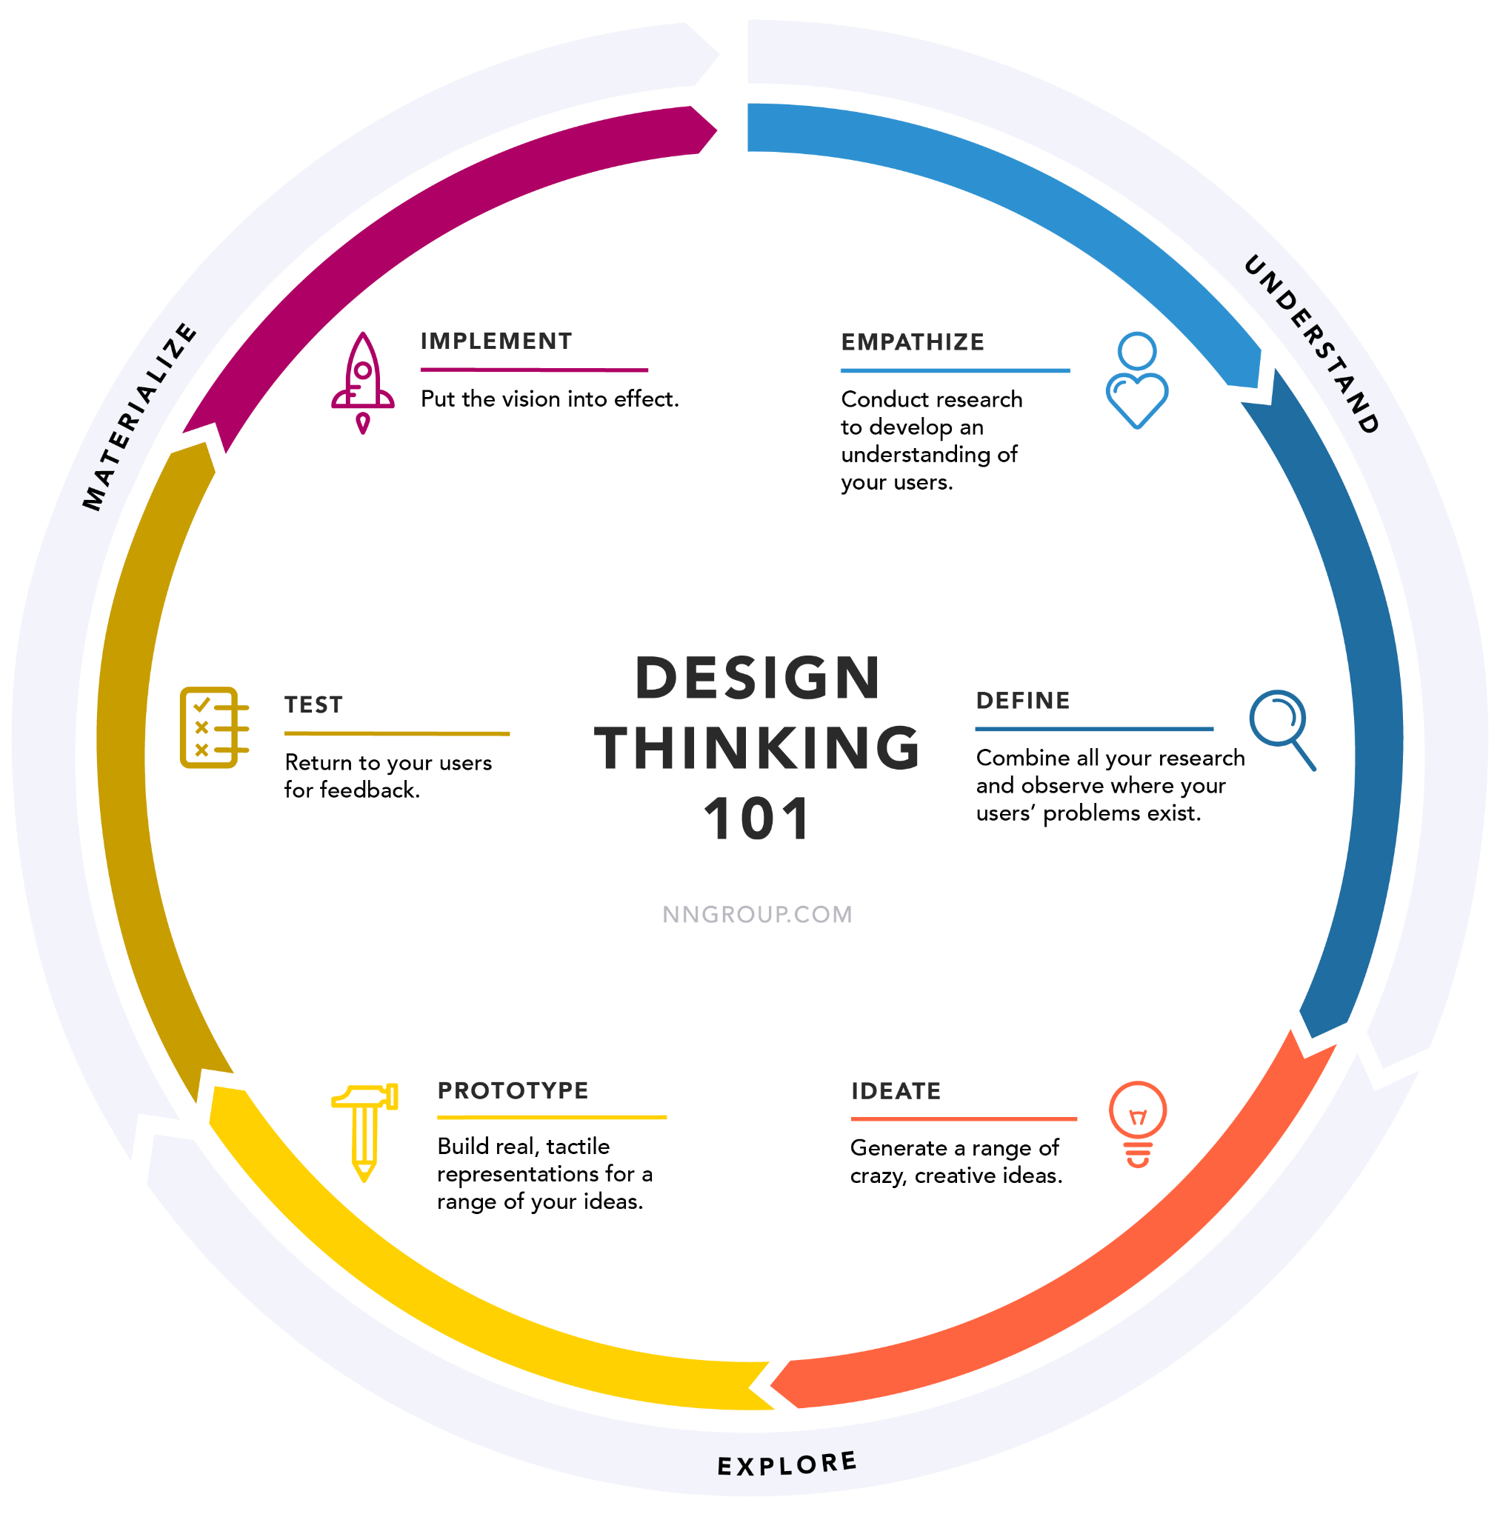

Slide 25
Thinking as a Process ? Format or Framework ?
Empathise – with your users
Define – your users’ needs, their problem, and your insights
Ideate – by challenging assumptions and creating ideas for innovative solutions
Prototype – to start creating solutions
Test – solutions
Order ?
Sequence/Parallel?

Slide 26
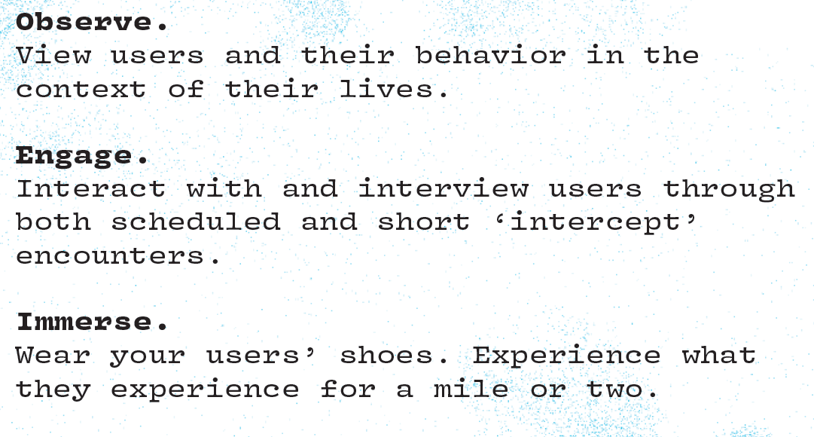
Card: Empathize
Foundation of human-centered design
Empathy for your users by learning their values

Slide 27
Card: Define
Unpack your empathy findings into needs and insights and cope a meaningful challenge
Actionable Problem Statement
POV: Your point of view is a unique design vision that is framed by your specific users not just defining the problem

Slide 28
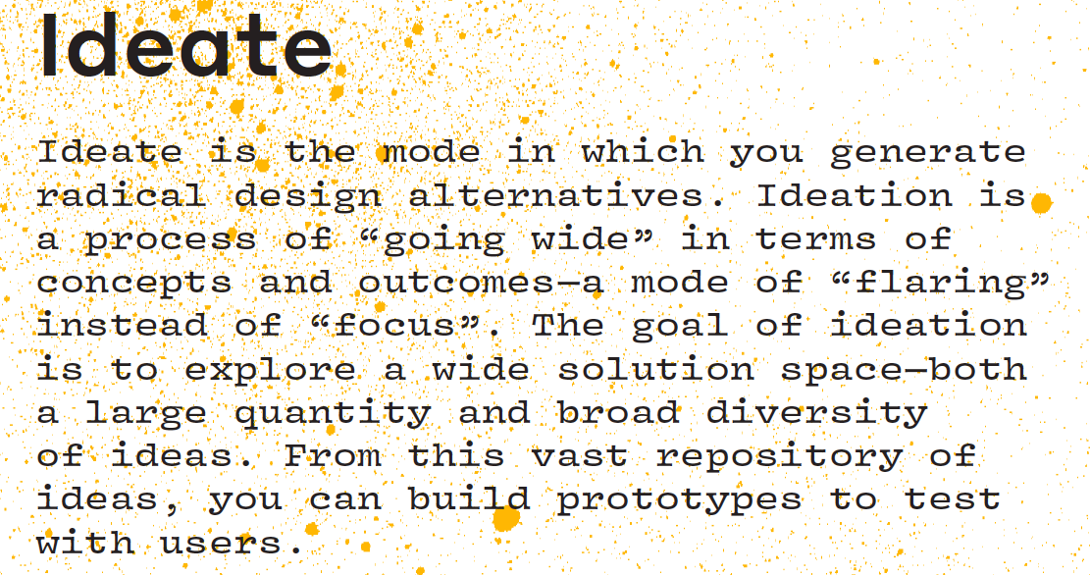

Slide 29
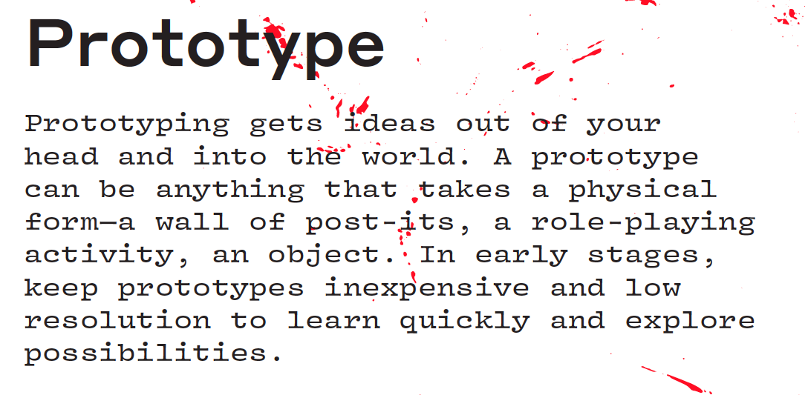

Slide 30
TEST
Test your solution
Gather feedback
Refine Solutions
Continue learning about users iteratively
Prototype as if you are right and test as if you are wrong!

Slide 31
“HANDS-ON” DESIGN THINKING WORKSHOP

Slide 32
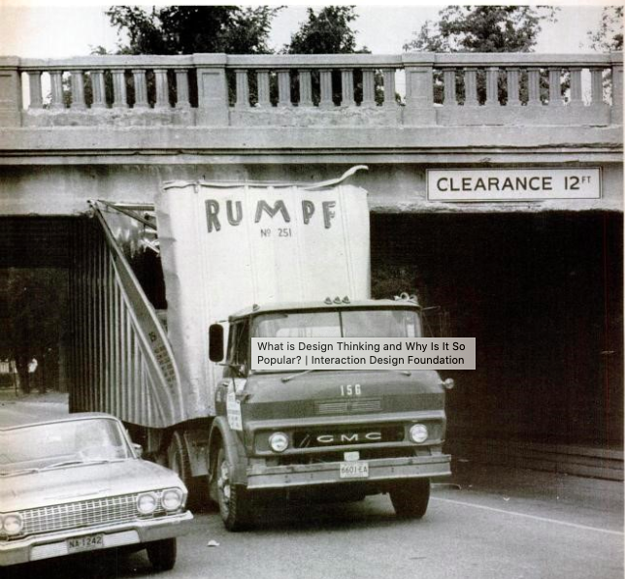
YOUR Problem…
Truck driver tried passing under bridge
Got stuck
Neither Forward nor backward
Massive traffic jams
How will you solve ?

Slide 33
REFERENCES
https://dschool.stanford.edu/resources/design-thinking-bootleg
https://www.interaction-design.org/literature/article/design-thinking-a-quick-overview
https://www.ideo.com/post/method-cards

